Slide 1
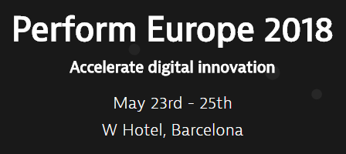







101 Jenkins with Dynatrace Shift-Left, Shift-Right through Dynatrace API & CLI Based on: https://github.com/dynatrace-innovationlab/jenkins-dynatrace-pipeline-tutorial
Followed by live Q&A:
Part of: http://bit.ly/onlineperfclinic
Get Dynatrace SaaS Trial: http://bit.ly/dtsaastrial
Listen to PurePerformance: http://bit.ly/pureperf
Andreas Grabner, Dynatrace @grabnerandi

Slide 2












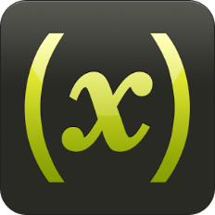




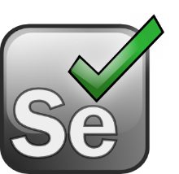









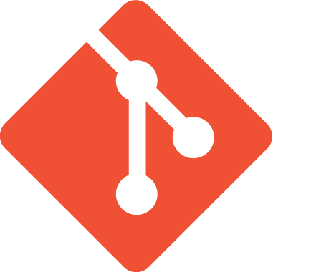
Shift-Left: Break Pipeline Earlier
Shift-Right: Tags, Deploys, Events
Dev
Perf/Test
Ops
Biz
Actionable Feedback Loops
Path to NoOps: Self-Healing, …
Notes:
But there is more than production! There is more we can do throughout the whole DevOps Toolchain

Slide 3
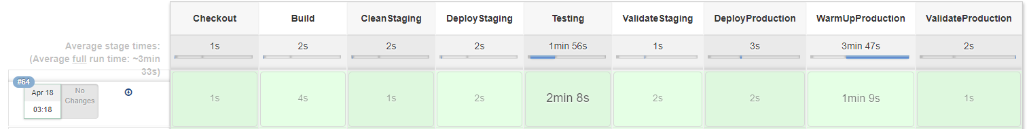
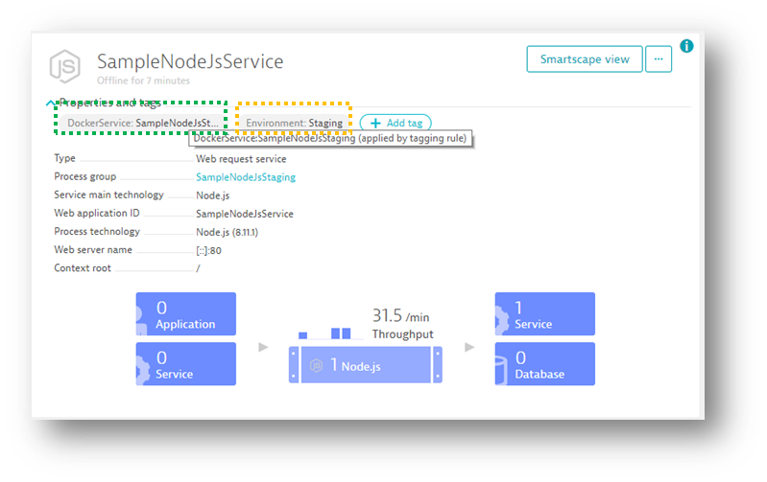
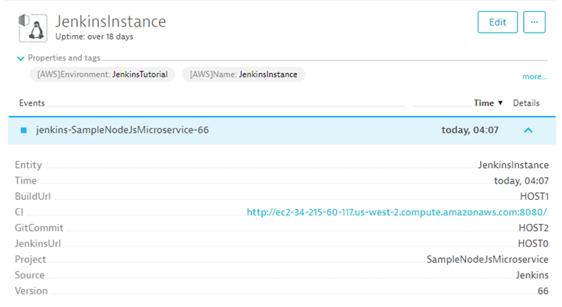
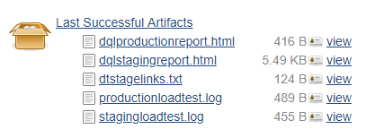
https://github.com/dynatrace-innovationlab/jenkins-dynatrace-pipeline-tutorial
Push Tags & Metadata
Push Events (Deploys, Tests..)
Pull data as artifacts

Slide 4
My Jenkins Installation On EC2 with some extra configurations

Slide 5
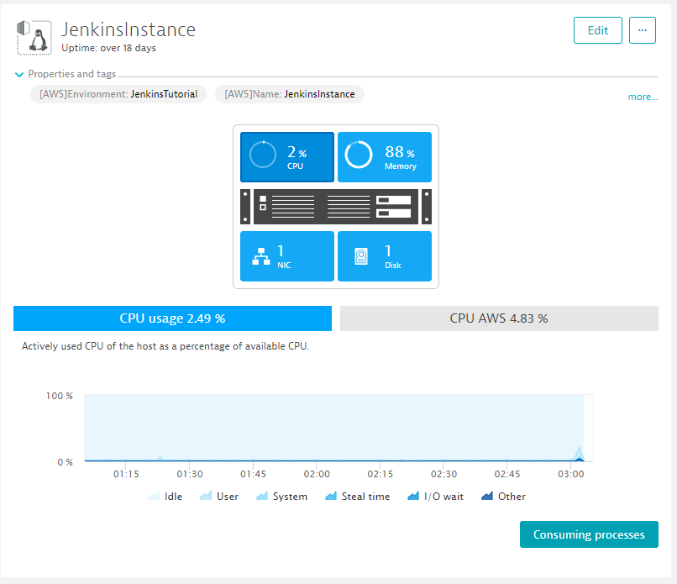
My Jenkins Installation
Running on an EC2 Linux Machine
Dynatrace OneAgent for Monitoring
Jenkins Version 2.115
Python 3 + PIP + requests package
Docker + Adding Jenkins to Docker Group
Installing Python3 for Dynatrace CLI:
sudo yum install python36
sudo yum install python36-pip
sudo ln -s /usr/bin/pip-3.6 /usr/bin/pip3
sudo pip3 install requests
Installing Python3 for Dynatrace CLI:
sudo yum install -y docker
sudo service docker start
sudo usermod -aG docker jenkins

Slide 6
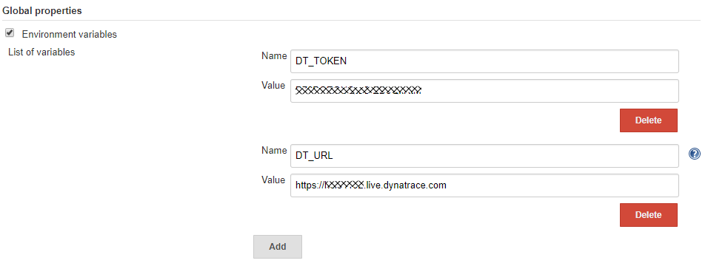
My Jenkins Settings
Global Properties for Dynatrace REST Calls
Security Setting to view HTML Report
Either via Tomact Command Line or via Jenkins Script Console
System.setProperty("hudson.model.DirectoryBrowserSupport.CSP", "")

Slide 7
My Jenkins Pipeline Pushing a Node.js Microservice from Staging to Prod

Slide 8
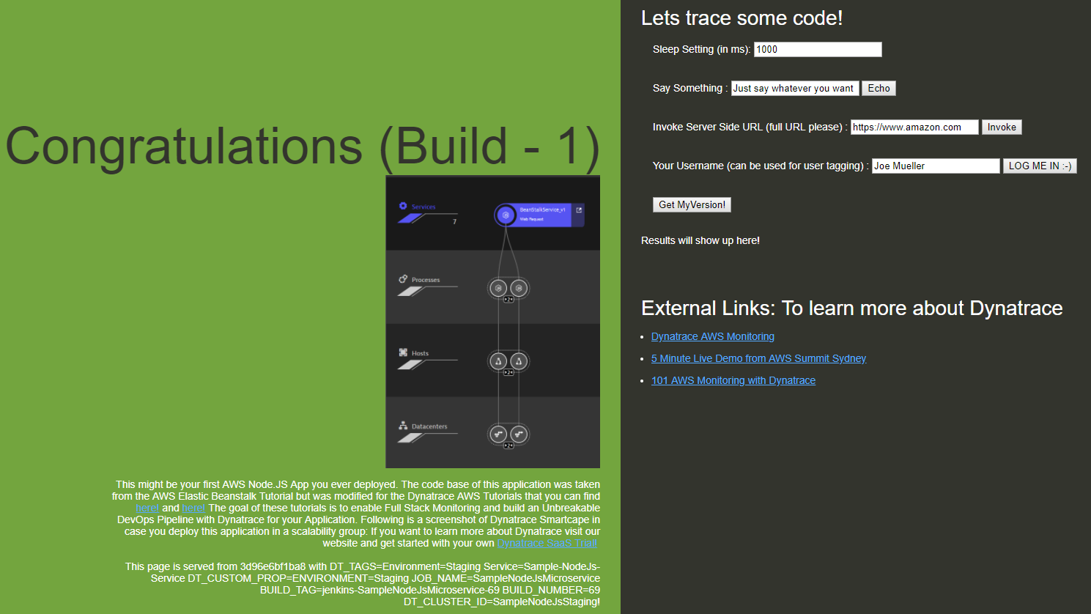
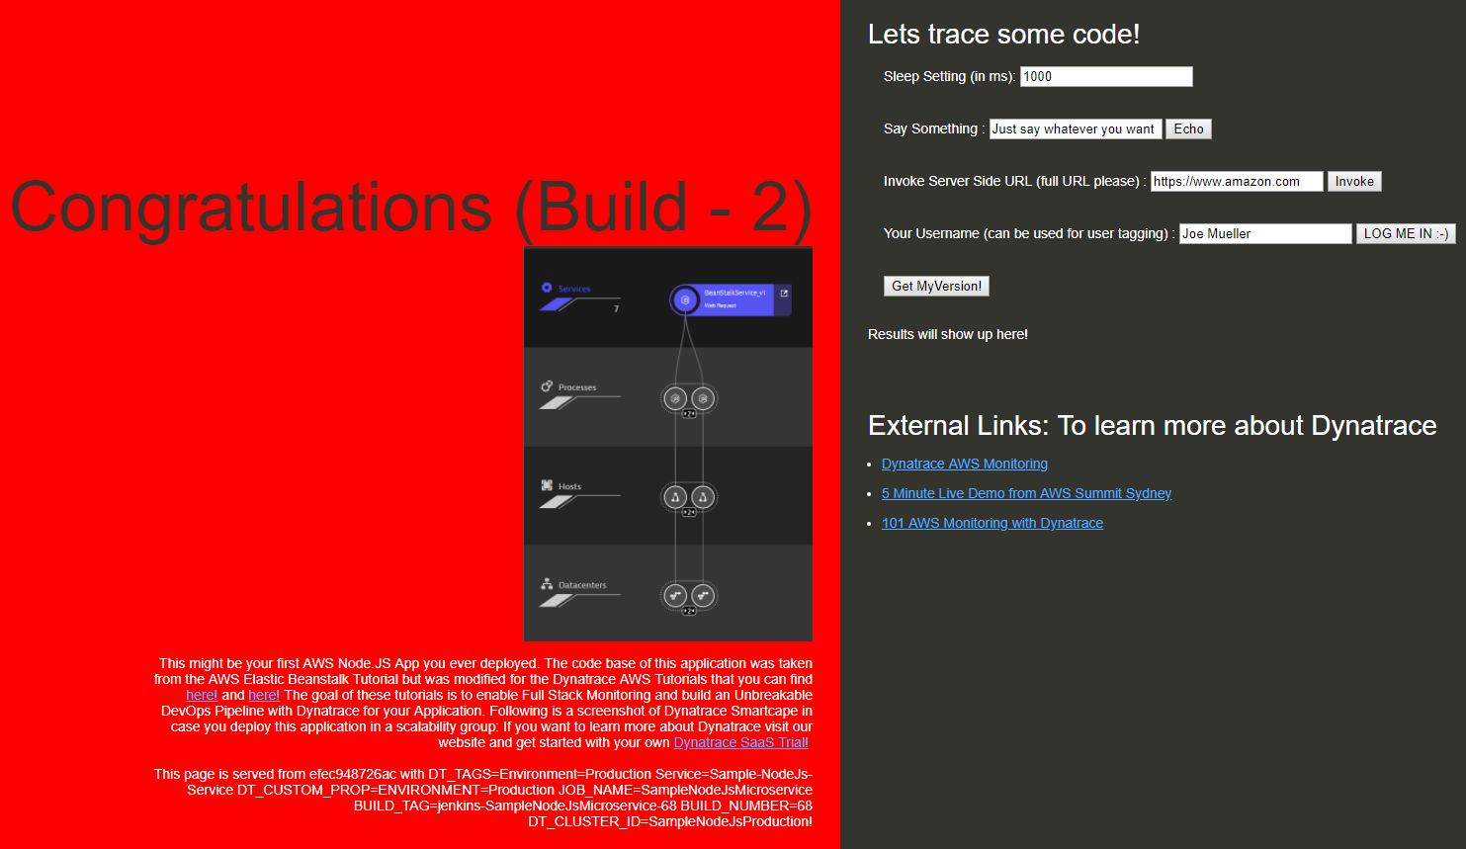
My App – Deployed on two docker containers: Staging vs Production – multiple builds
Staging: http://myjenkinsmachine:80
Production: http://myjenkinsmachine:90
Docker
EC2 Instance running Jenkins and Docker

Slide 9
Checkout | Checkout application source and Dynatrace CLI
Build | Docker.build: Build Application Docker Container
Clean Staging | Stop any previously running Docker Container in Staging
Deploy Staging | #1: Docker.run: Pass DT_TAGS=Environment=Staging, DT_CUSTOM_PROP=xxx and DT_CLUSTER_ID=yyy via –e argument #2: Push Dynatrace Deployment Information on HOST and SERVICE via pushdeployment.sh script
Testing | #1: Push Start & Stop Load Testing Events on SERVICE via pushevent.sh #2: Run Load Test and archive Load Testing Results
Validate Staging | #1: Validate that Dynatrace detected no problems via checkforproblems.sh #2: Create Dynatrace HTML Report & Link to Dynatrace Service Dashboard via Dynatrace CLI: python3 dtcli.py …
Deploy Production | #1: Docker.run: Pass DT_TAGS=Environment=Production, DT_CUSTOM_PROP=xxx and DT_CLUSTER_ID=yyy via –e argument #2: Push Dynatrace Deployment Information on HOST and SERVICE via pushdeployment.sh script
Warm-Up Production | #1: Push Start & Stop Load Testing Events on SERVICE via pushevent.sh #2: Run a Load Test to warm up production and archive Testing Results
Validate Production | #1: Validate that Dynatrace detected no problems via checkforproblems.sh #2: Create Dynatrace HTML Report & Link to Dynatrace Service Dashboard via Dynatrace CLI: python3 dtcli.py …

Slide 10
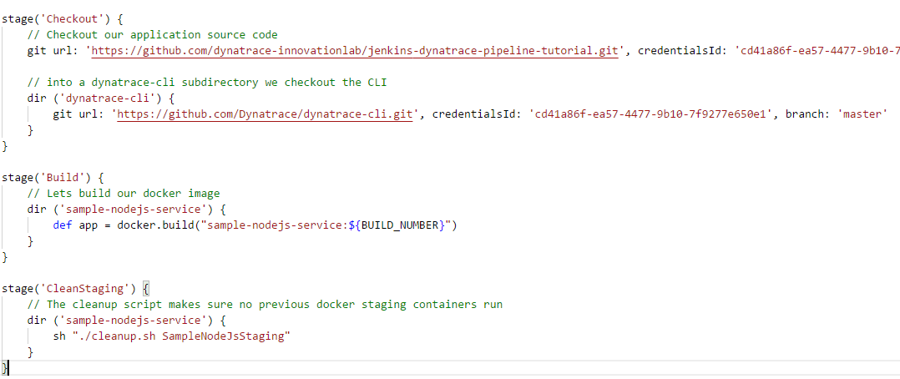
Checkout, Build & Clean Staging

Slide 11
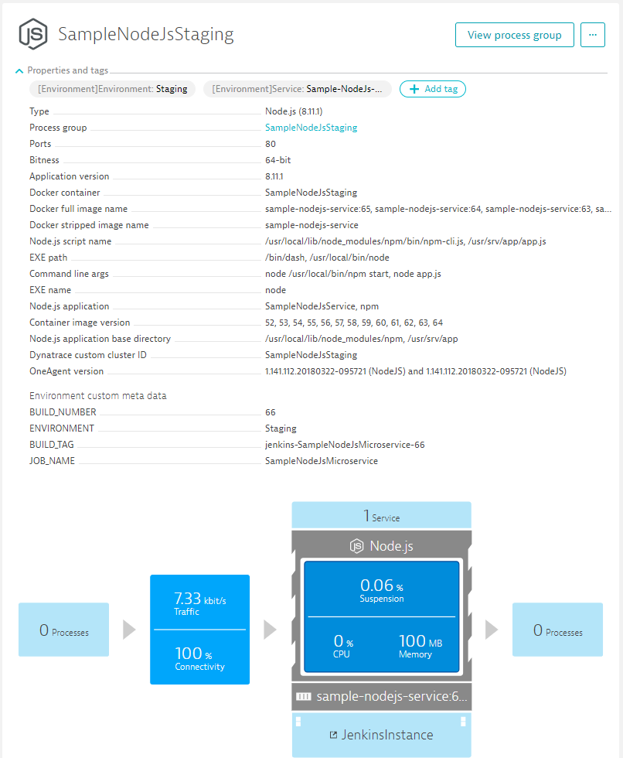
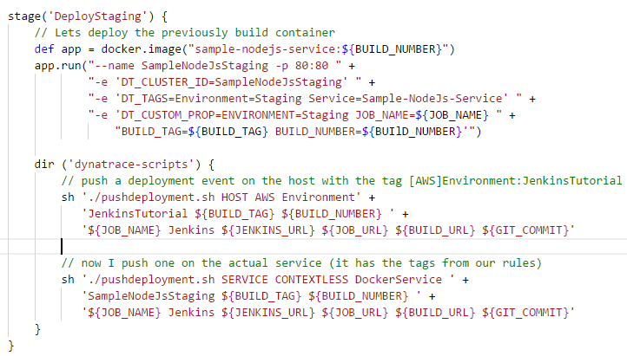
Deploy Staging – Part 1: Deploy Container

Slide 12
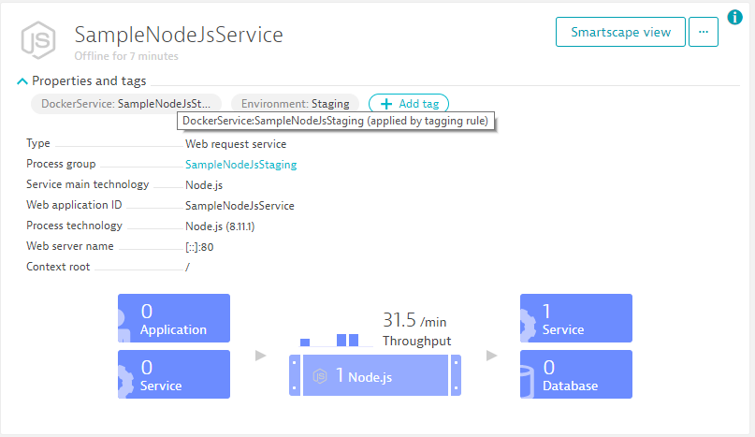
Deploy Staging – Part 2: Automatic Tagging Rules
Process
Service hosted by Process
Rules

Slide 13
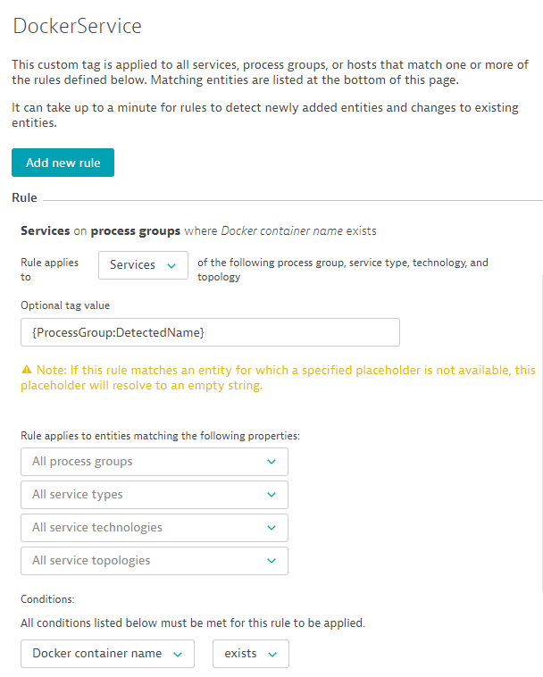
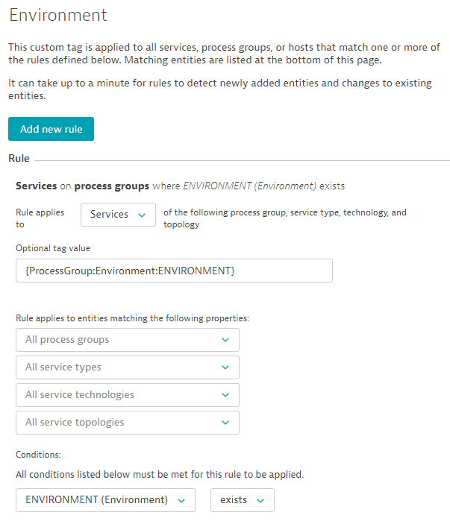
Deploy Staging – Part 2: Automatic Tagging Rules

Slide 14
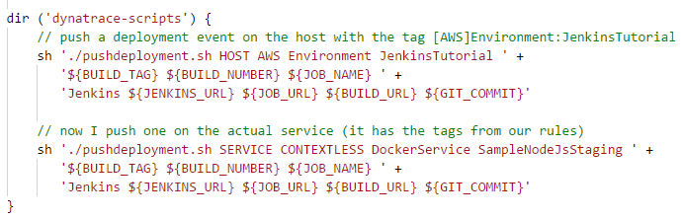
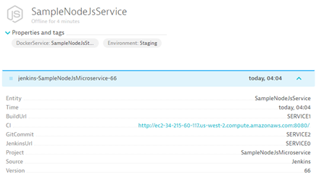
Deploy Staging – Part 3: Push Deployment Information

Slide 15
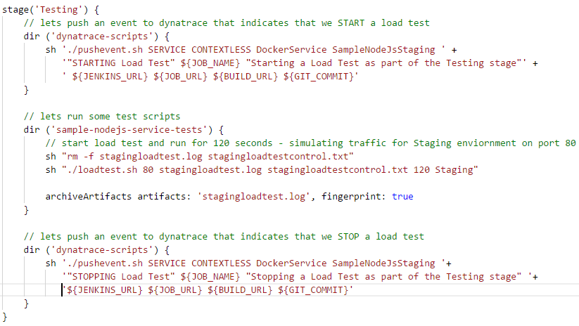
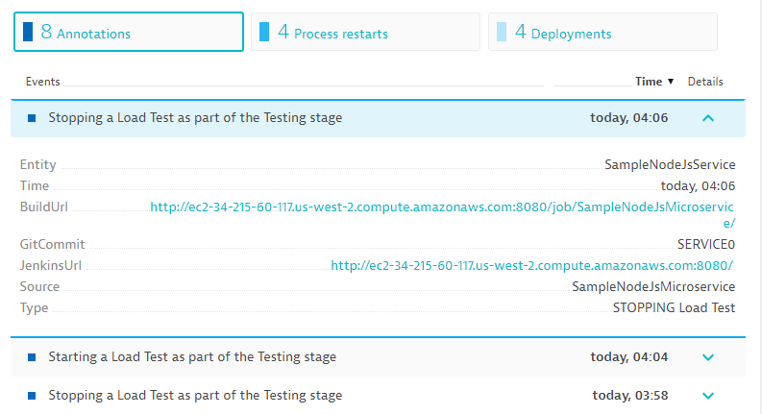
Testing: Push Start & Stop Event as Custom Annotation

Slide 16
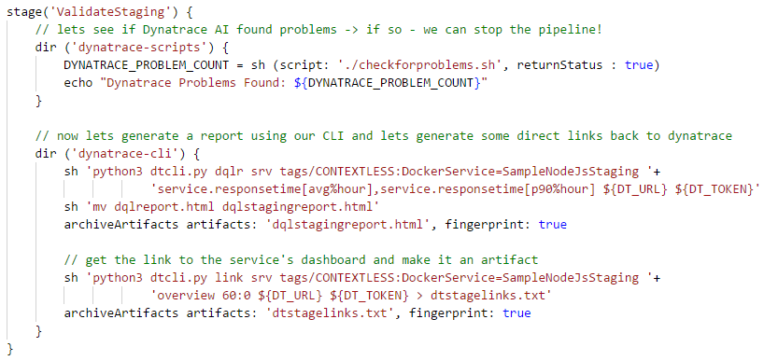
Validate Staging: Collect Dynatrace Information – Option to Break the Pipeline

Slide 17
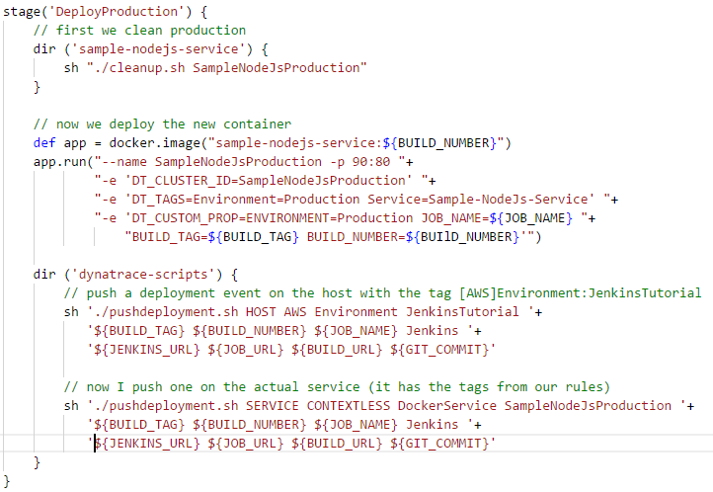
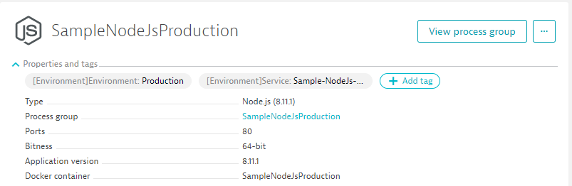
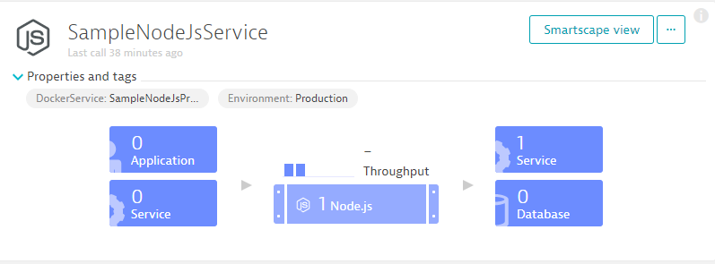
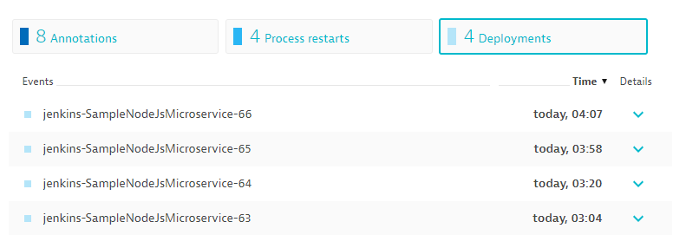
Deploy Production: Same as Staging – just different TAGS
Rules

Slide 18
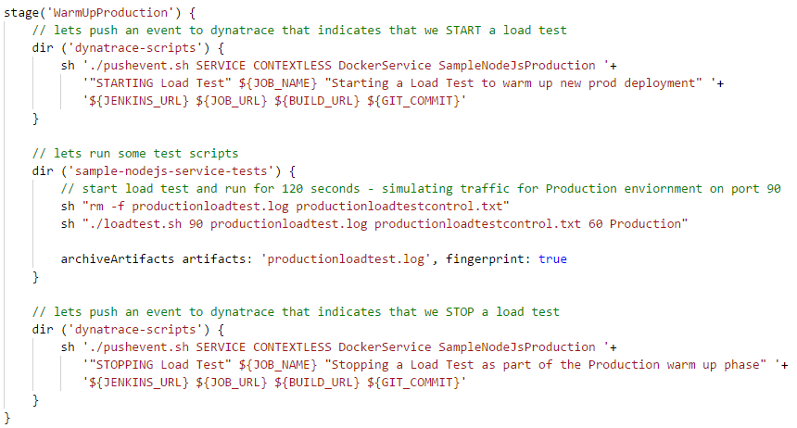
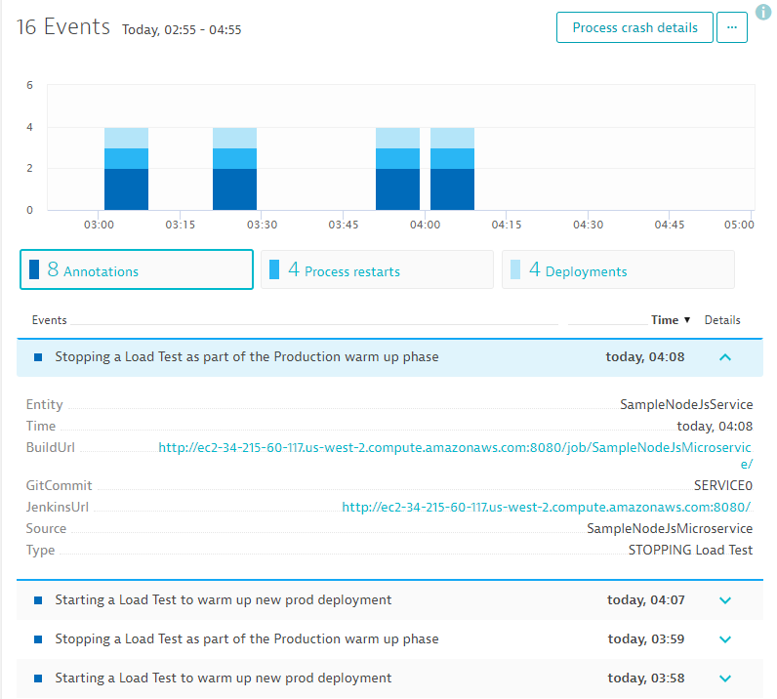
Warm-Up Production: Just some load tests as before

Slide 19
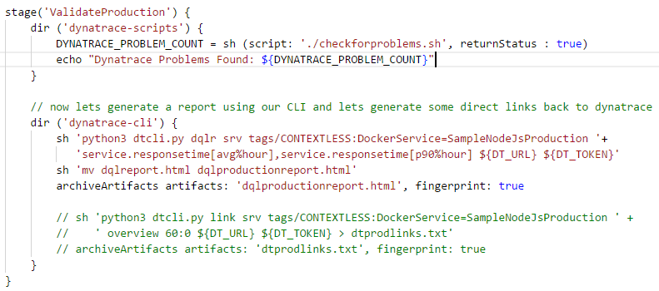
Validate Production: Ready to go GREEN / BLUE?

Slide 20
LIVE DEMO!! Getting Started with the Tutorial

Slide 21
Load Testing Integration Works for Neotys, JMeter, Gatling, Load Runner …

Slide 22
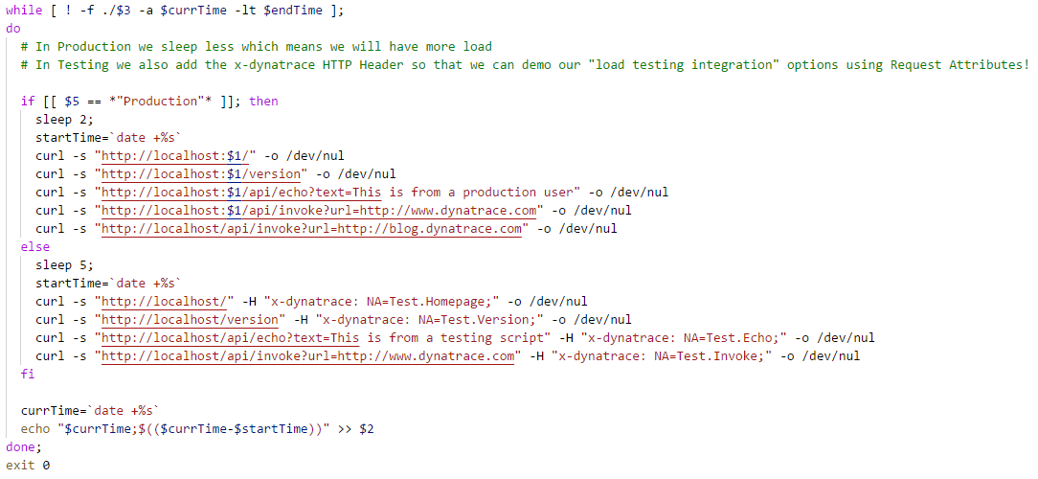
Background on Load Testing Integration: Adding HTTP Headers

Slide 23
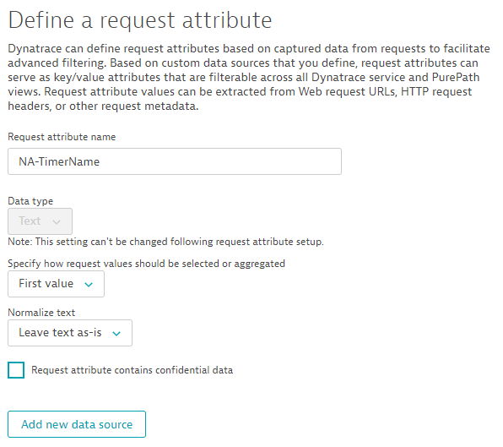
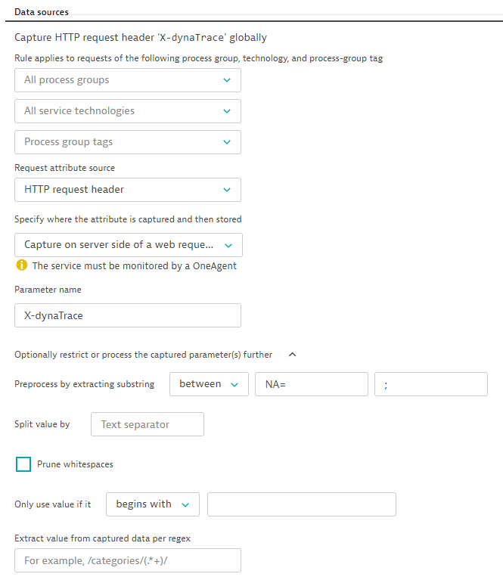
Background on Load Testing Integration: Defining Request Attributes

Slide 24
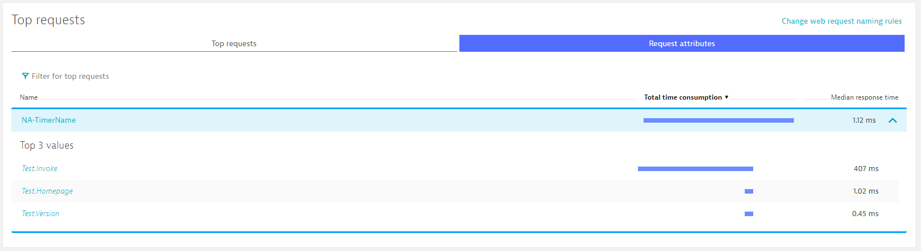
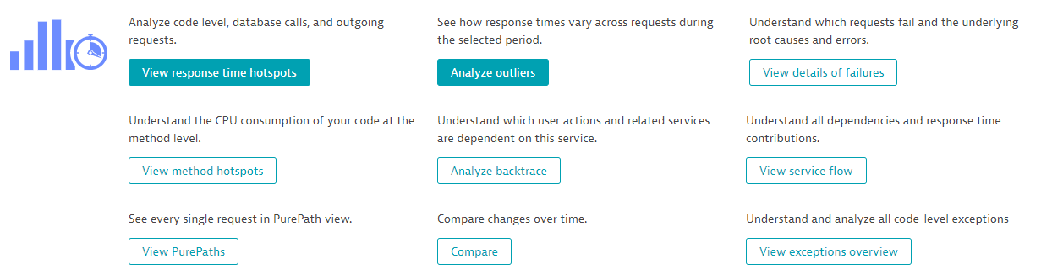
Background on Load Testing Integration: Request Tag-based Analysis

Slide 25
More concepts? Check the AWS DevOps Tutorial

Slide 26
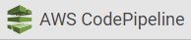
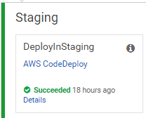
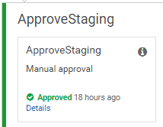
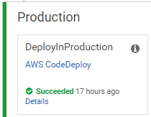
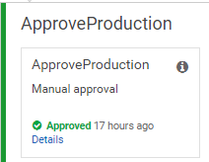
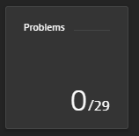
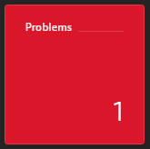


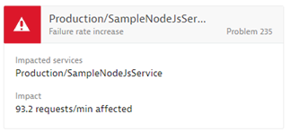
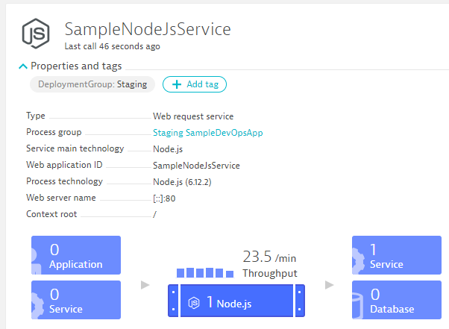
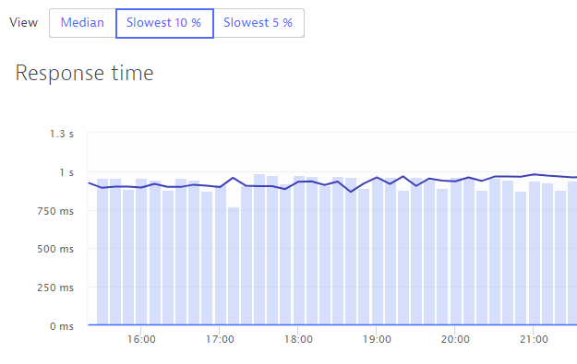
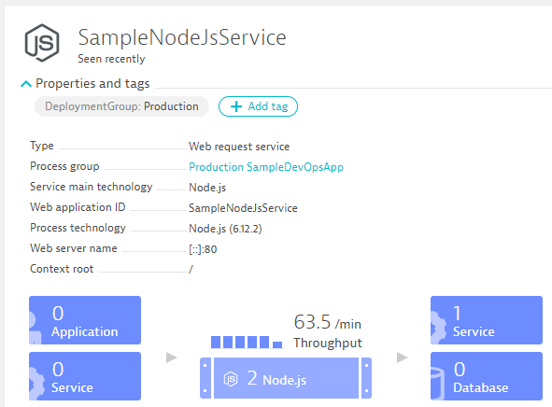
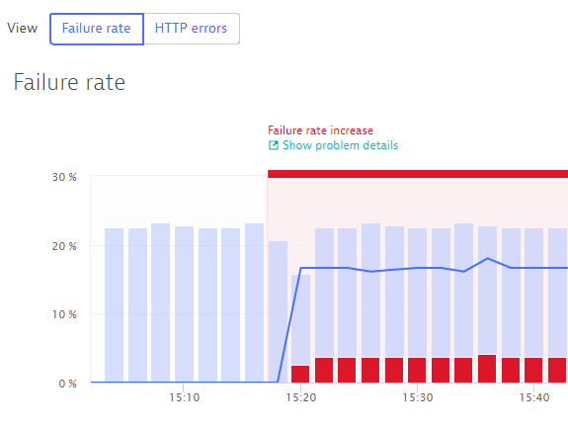

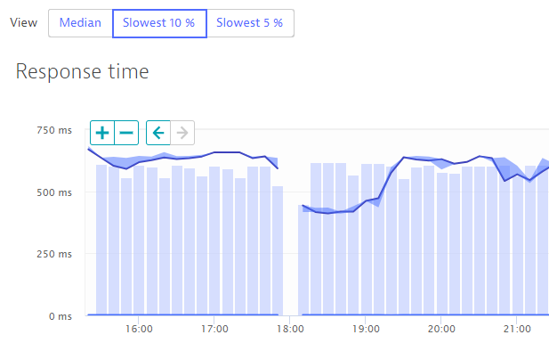
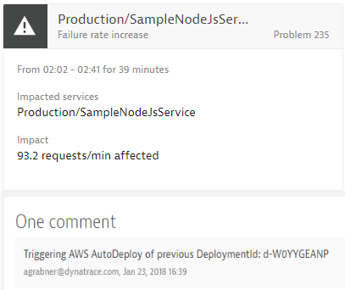
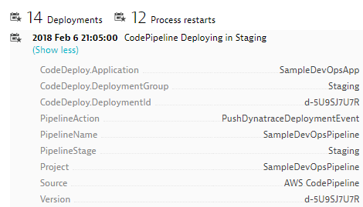


https://github.com/Dynatrace/AWSDevOpsTutorial
Self-Healed
Auto-Approve!
Auto-Approve!
Auto-Reject!
Auto-Reject!
pushDynatraceDeploymentEvent
Pushes Deployment Info to Dynatrace Entities
validateBuildDynatraceWorker
Compares Builds and Approves/Rejects Pipeline
pushDynatraceDeploymentEvent
Pushes Deployment Info to Dynatrace Entities
validateBuildDynatraceWorker
Validates Production and Approves/Rejects Pipeline
Build 6
Production
handleDynatraceProblemNotification
Executes Auto-Remediating Actions, e.g: Rollback
Build 7
Production

Slide 27
Additional Resources & Reminders
Get your Dynatrace SaaS or Managed Trial: http://bit.ly/dtsaastrial
Meetups and User Groups: We are happy to present!
April 2017: Use Groups Denver, Minneapolis, Detroit, Dallas; AWS Summit SFO, …
May 2018: User Groups Houston, Chicago, Toronto; Dynatrace PERFORM EMEA in Barcelona, Spain
More events: https://www.dynatrace.com/company/events/
More user groups: https://community.dynatrace.com/community/display/PUBEVENTS/Events
Online Training Material
Dynatrace University: http://university.dynatrace.com
Dynatrace FullStack YouTube Playlist: http://bit.ly/oneagenttutorials
Dynatrace Coffee Breaks: http://dynatrace.ai/coffeebreak
Dynatrace Power Demos: https://www.dynatrace.com/demos/
Sample Applications, Tutorials & more
easyTravel: http://bit.ly/dteasytravel
AWS Tutorial w Sample Apps: https://github.com/Dynatrace/AWSMonitoringTutorials
Dynatrace CLI: https://github.com/Dynatrace/dynatrace-cli
Unbreakable Pipeline Tutorial: https://github.com/Dynatrace/AWSDevOpsTutorial
PurePerformance Podcast: http://bit.ly/pureperf

